Slide 1
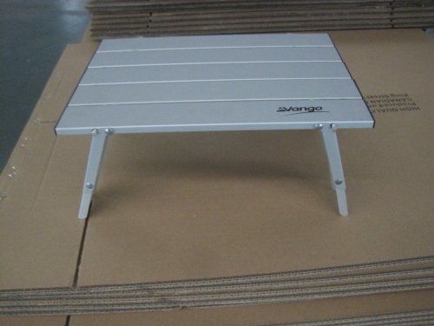
HAWTHORN TABLE
2 secure rods need to be pushed through table top to hold in position
Remove rods to fold table
Rods are stored in clips on underside of table
Foldable legs to 2 heights

